Slide 1
CS 316: Introduction to Deep Learning
Advanced Language Models – LSTM & GRU
Dr Abdul Samad

Slide 2

Gradients
Long chain of dependencies for backprop
Need to keep a lot of intermediate values in memory
Butterfly effect style dependencies
Gradients can vanish or diverge (more on this later)
Clipping to prevent divergence rescales to gradient of size at most

Slide 3
Recurrent Neural Networks (with hidden state)
Hidden State update
Observation update

Slide 4

Analysis of gradient in RNN
Consider a simple RNN
$$h_{t}=f\left(x_{t},h_{t−1},w_{h}\right)$$
$$o_{t}=g\left(h_{t},w_{0}\right)$$
Loss is calculated as
$$L\left(x_{1},…,x_{T},y_{1},…,y_{T},w_{h},w_{0}\right)=\frac{1}{T}\sum_{t=1}^{T}{l(y_{t},0_{t})}$$

Slide 5

Analysis of gradient in RNN
$$\frac{∂L}{∂w_{h}}=\frac{1}{T}\sum_{t=1}^{T}{\frac{∂l(y_{t},0_{t})}{∂w_{h}}}$$
$$=\frac{1}{T}\sum_{t=1}^{T}{\frac{∂l(y_{t},0_{t})}{∂o_{t}}}\frac{∂g(h_{t},w_{0})}{∂h_{t}}\frac{∂h_{t}}{∂w_{h}}$$
Notes:
where ff and gg are transformations of the hidden layer and the output layer, respectively. Hence, we have a chain of values {…,(xt−1,ht−1,ot−1),(xt,ht,ot),…}{…,(xt−1,ht−1,ot−1),(xt,ht,ot),…} that depend on each other via recurrent computation. The forward propagation is fairly straightforward. All we need is to loop through the (xt,ht,ot)(xt,ht,ot) triples one time step at a time. The discrepancy between output otot and the desired label ytyt is then evaluated by an objective function across all the TT time steps as

Slide 6
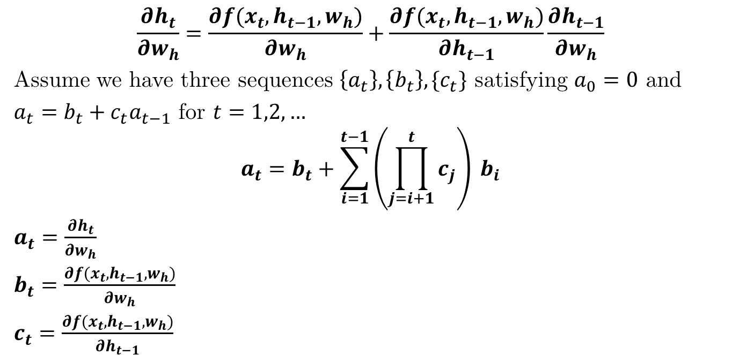
Analysis of gradient in RNN
$$\frac{∂h_{t}}{∂w_{h}}=\frac{∂f(x_{t},h_{t−1},w_{h})}{∂w_{h}}+\frac{∂f(x_{t},h_{t−1},w_{h})}{∂h_{t−1}}\frac{∂h_{t−1}}{∂w_{h}}$$
Assume we have three sequences $\left\{a_{t}\right\},\left\{b_{t}\right\},\{c_{t}\}$ satisfying $a_{0}=0$ and
$a_{t}=b_{t}+c_{t}a_{t−1}$ for $t=1,2,…$
$$a_{t}=b_{t}+\sum_{i=1}^{t−1}{\left(\prod_{j=i+1}^{t}{c_{j}}\right)} b_{i}$$
$a_{t}=\frac{∂h_{t}}{∂w_{h}}$
$b_{t}=\frac{∂f(x_{t},h_{t−1},w_{h})}{∂w_{h}}$
$c_{t}=\frac{∂f(x_{t},h_{t−1},w_{h})}{∂h_{t−1}}$
Notes:
The first and the second factors of the product in (8.7.3) are easy to compute. The third factor$∂ht/∂wh$is where things get tricky, since we need to recurrently compute the effect of the parameter $w_{h}$ on $h_{t}$. According to the recurrent computation in (8.7.1), $h_{t }$depends on both $h_{\left\{t−1\right\}}$ and $w_{h}$, where computation of $h_{t−1}$also depends on$w_{h}$. Thus, using the chain rule yields

Slide 7

Analysis of gradient of RNN
$$\frac{∂h_{t}}{∂w_{h}}=\frac{∂f(x_{t},h_{t−1},w_{h})}{∂w_{h}}+\sum_{i=1}^{t−1}{\left(\prod_{j=i+1}^{t}{\frac{∂f(x_{j},h_{j−1},w_{h})}{∂h_{j−1}}}\right)}\frac{∂f(x_{i},h_{i−1},w_{h})}{∂w_{h}}$$

Slide 8
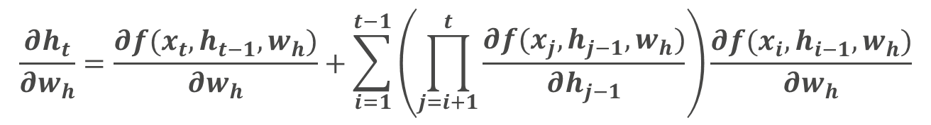
Latent State Gradient
Gradient Recursion
$$\frac{∂h_{t}}{∂w_{h}}=\frac{∂f(x_{t},h_{t−1},w_{h})}{∂w_{h}}+\sum_{i=1}^{t−1}{\left(\prod_{j=i+1}^{t}{\frac{∂f(x_{j},h_{j−1},w_{h})}{∂h_{j−1}}}\right)}\frac{∂f(x_{i},h_{i−1},w_{h})}{∂w_{h}}$$
Output
o
Explanation
h
Observation
x

Slide 9
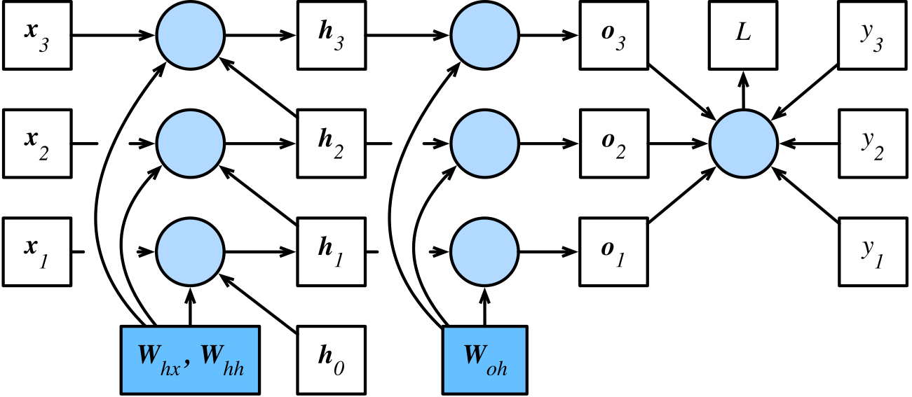
Computational Graph

Slide 10



Class Activity
$$\frac{∂L}{∂o_{t}}=$$
$$\frac{∂L}{∂w_{qh}}=$$
$$\frac{∂L}{∂h_{T}}=$$
$$\frac{∂L}{∂W_{hx}}=$$
$$\frac{∂L}{∂W_{hh}}=$$

Slide 11

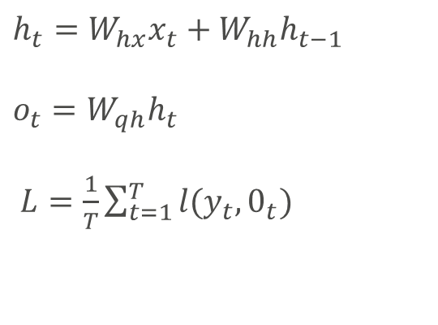
Toy Model
$h_{t}=W_{hx}x_{t}+W_{hh}h_{t−1}$
$o_{t}=W_{qh}h_{t}$
$L=\frac{1}{T}\sum_{t=1}^{T}{l(y_{t},0_{t})}$
$$\frac{∂L}{∂o_{t}}=\frac{∂l(o_{t}, y_{t})}{T.∂o_{t}}∈R^{q}$$

Slide 12

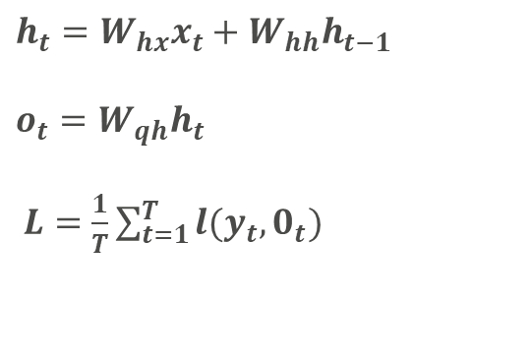
Toy Model
$h_{t}=W_{hx}x_{t}+W_{hh}h_{t−1}$
$o_{t}=W_{qh}h_{t}$
$L=\frac{1}{T}\sum_{t=1}^{T}{l(y_{t},0_{t})}$
$$\frac{∂L}{∂w_{qh}}=\sum_{t=1}^{T}{prod \left(\frac{∂L}{∂o_{t}},\frac{∂o_{t}}{∂w_{qh}}\right)}$$
Notes:
Now, we can calculate the gradient of the objective function with respect to the parameter $W_{qh}$ in the output layer: $\frac{∂L}{∂Wqh}$ $∈R^{q×h}$. Based on Fig. 8.7.2, the objective function $L$ depends on $W_{qh}$ via $o_{1},…,o_{T}$. Using the chain rule yields

Slide 13


Toy Model
$h_{t}=W_{hx}x_{t}+W_{hh}h_{t−1}$
$o_{t}=W_{qh}h_{t}$
$L=\frac{1}{T}\sum_{t=1}^{T}{l(y_{t},0_{t})}$
$$\frac{∂L}{∂h_{T}}=prod\left(\frac{∂L}{∂o_{t}},\frac{∂o_{t}}{∂h_{T}}\right)$$
$$\frac{∂L}{∂h_{t}}=prod\left(\frac{∂L}{∂h_{t+1}},\frac{∂h_{t+1}}{∂h_{T}}\right)+prod\left(\frac{∂L}{∂o_{t}},\frac{∂o_{t}}{∂h_{T}}\right)$$
$$\frac{∂L}{∂h_{t}}=\sum_{i=t}^{T}{{\left(W_{hh}^{T}\right)}^{T−i}}W_{qh}^{T}\frac{∂L}{∂o_{T+t−i}} 1≤t≤T$$
Notes:
Next, as shown in Fig. 8.7.2, at the final time step T the objective function L depends on the hidden state hT only via oT. Therefore, we can easily find the gradient ∂L/∂hT∈Rh using the chain rule:
It gets trickier for any time step $t<T$, where the objective function $L$ depends on $h_{t}$ via $h_{t+1}$ and $o_{t}$. According to the chain rule, the gradient of the hidden stat $\frac{∂L}{∂ht}∈R_{h}$ at any time step $t<T$ can be recurrently computed as:

Slide 14


Toy Model
$h_{t}=W_{hx}x_{t}+W_{hh}h_{t−1}$
$o_{t}=W_{qh}h_{t}$
$L=\frac{1}{T}\sum_{t=1}^{T}{l(y_{t},0_{t})}$
$$\frac{∂L}{∂W_{hx}}=\sum_{i=t}^{T}{prod\left(\frac{∂L}{∂h_{t}},\frac{∂h_{t}}{∂W_{hx}}\right)}$$
$$\frac{∂L}{∂W_{hh}}=\sum_{i=t}^{T}{prod\left(\frac{∂L}{∂h_{t}},\frac{∂h_{t}}{∂W_{hh}}\right)}$$
Notes:
Next, as shown in Fig. 8.7.2, at the final time step T the objective function L depends on the hidden state hT only via oT. Therefore, we can easily find the gradient ∂L/∂hT∈Rh using the chain rule:
It gets trickier for any time step $t<T$, where the objective function $L$ depends on $h_{t}$ via $h_{t+1}$ and $o_{t}$. According to the chain rule, the gradient of the hidden stat $\frac{∂L}{∂ht}∈R_{h}$ at any time step $t<T$ can be recurrently computed as:

Slide 15
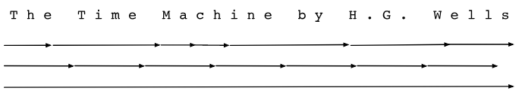
Truncated BPTT
Don’t truncate (naive strategy, costly and divergent)
Truncate at fixed intervals (standard approach, is approximation but works well)
Variable length (Tallec and Olivier, 2015)

Slide 16


Paying attention to a sequence
Not all observations are equally relevant
Only remember the relevant ones
Need mechanism to pay attention (update gate)
Need mechanism to forget (reset gate)
Notes:
We might encounter a situation where an early observation is highly significant for predicting all future observations. Consider the somewhat contrived case where the first observation contains a checksum and the goal is to discern whether the checksum is correct at the end of the sequence. In this case, the influence of the first token is vital. We would like to have some mechanisms for storing vital early information in a memory cell. Without such a mechanism, we will have to assign a very large gradient to this observation, since it affects all the subsequent observations.
We might encounter situations where some tokens carry no pertinent observation. For instance, when parsing a web page there might be auxiliary HTML code that is irrelevant for the purpose of assessing the sentiment conveyed on the page. We would like to have some mechanism for skipping such tokens in the latent state representation.
We might encounter situations where there is a logical break between parts of a sequence. For instance, there might be a transition between chapters in a book, or a transition between a bear and a bull market for securities. In this case it would be nice to have a means of resetting our internal state representation.

Slide 17

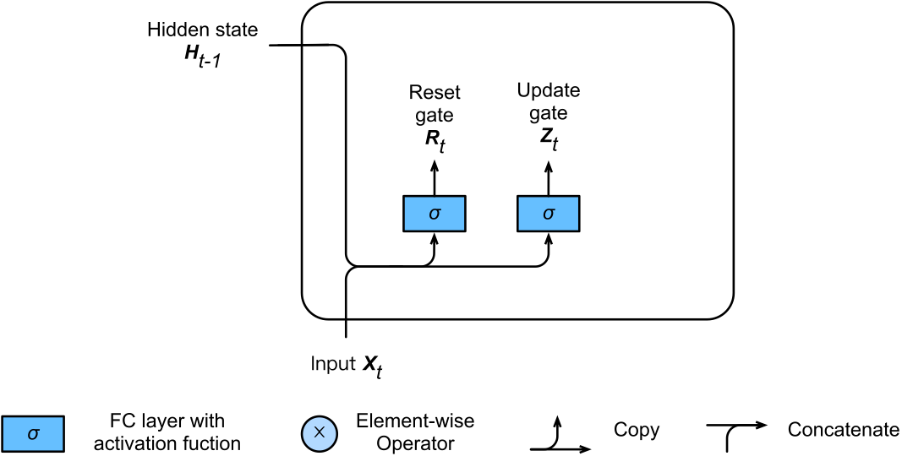
Gating
Notes:
The key distinction between vanilla RNNs and GRUs is that the latter support gating of the hidden state. This means that we have dedicated mechanisms for when a hidden state should be updated and also when it should be reset.
These mechanisms are learned and they address the concerns listed above. For instance, if the first token is of great importance we will learn not to update the hidden state after the first observation. Likewise, we will learn to skip irrelevant temporary observations. Last, we will learn to reset the latent state whenever needed.

Slide 18
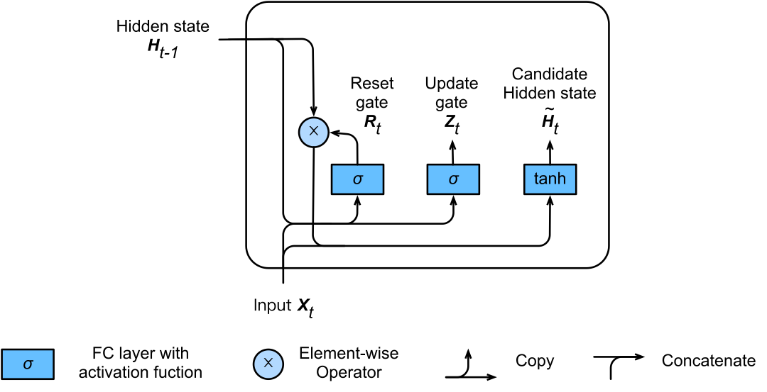
Candidate Hidden State

Slide 19
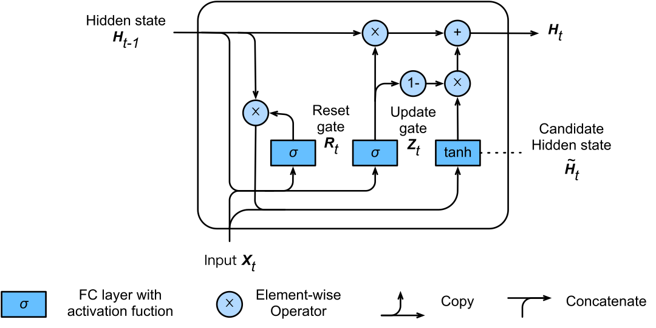
GRU-Hidden State

Slide 20
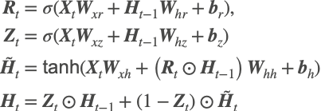
GRU-Summary
Notes:
Reset gates help capture short-term dependencies in sequences.
Update gates help capture long-term dependencies in sequences.

Slide 21
Long Short Term Memory-LSTM
Forget gate Shrink values towards zero
Input gate Decide whether we should ignore the input data
Output gate Decide whether the hidden state is used for the output generated by the LSTM
Hidden state and Memory cell
Notes:
LSTM introduces a memory cell (or cell for short) that has the same shape as the hidden state (some literatures consider the memory cell as a special type of the hidden state), engineered to record additional information.
One gate is needed to read out the entries from the cell. We will refer to this as the output gate. A second gate is needed to decide when to read data into the cell. We refer to this as the input gate. Last, we need a mechanism to reset the content of the cell, governed by a forget gate. The motivation for such a design is the same as that of GRUs, namely to be able to decide when to remember and when to ignore inputs in the hidden state via a dedicated mechanism.

Slide 22

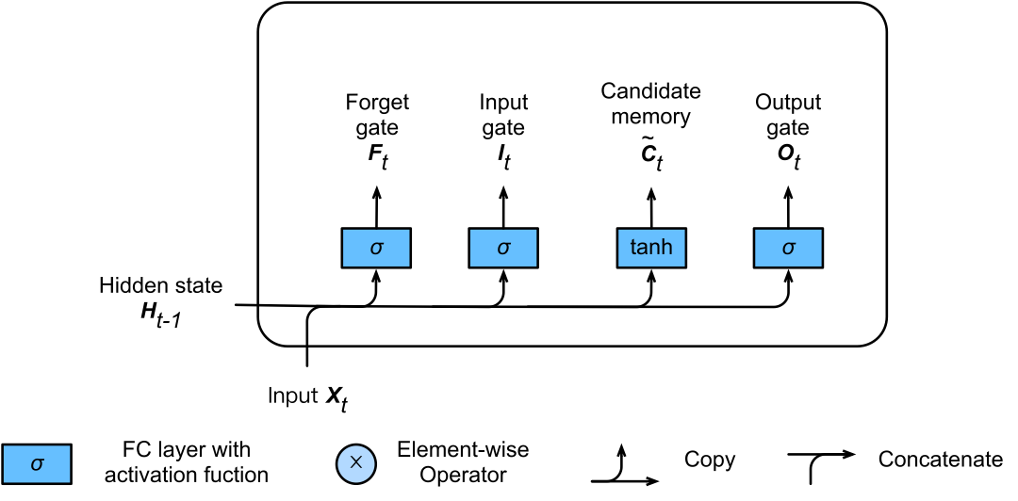
Gates

Slide 23
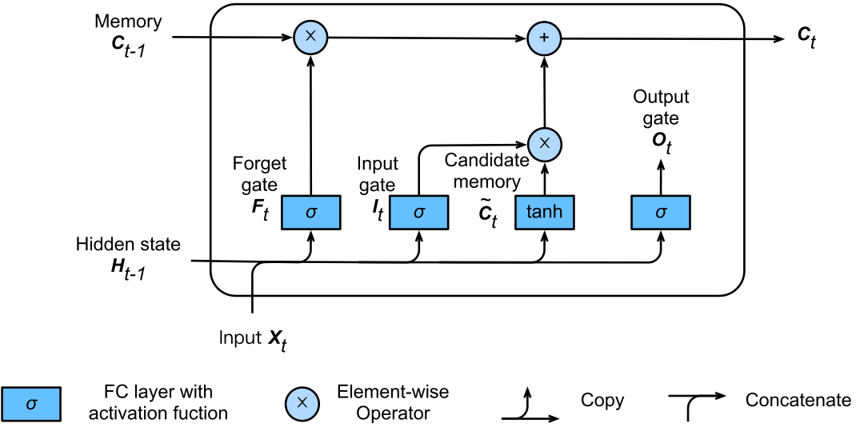
Candidate Memory Cell

Slide 24
Memory Cell
Notes:
the input gate ItIt governs how much we take new data into account via C~tC~t and the forget gate FtFt addresses how much of the old memory cell content Ct−1∈Rn×hCt−1∈Rn×h we retain

Slide 25
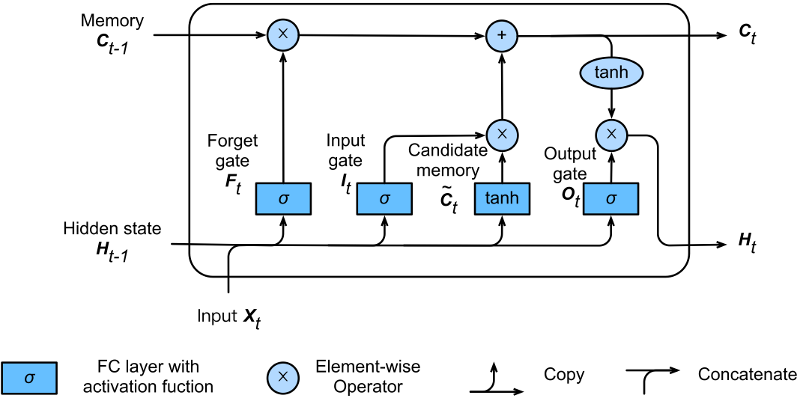
Hidden State / Output

Slide 26
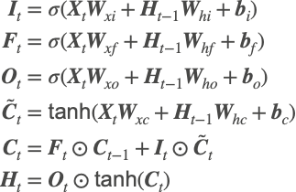
Hidden State / Output
Notes:
Whenever the output gate approximates 1 we effectively pass all memory information through to the predictor, whereas for the output gate close to 0 we retain all the information only within the memory cell and perform no further processing.

